Slide 1
Welcome

Slide 2
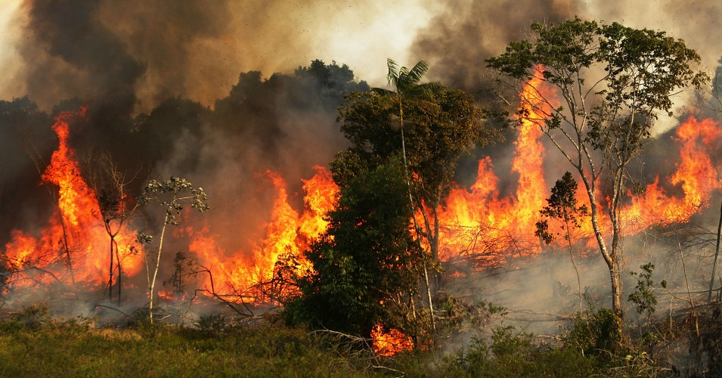
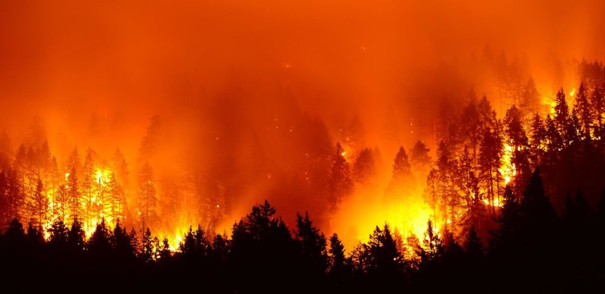
2

Slide 3
Outlines
Motivation For Choosing CNN
Datasets
CNN & Transfer Learning
Previous work
Methodology
Result And Discussion
Conclusion
Limitations
Future Plan
3

Slide 4
Motivation For Choosing CNN
Lack of functionalities in pre-existing traditional approaches
Convolutional neural networks can extract informative features from images
It has the highest accuracy among all algorithms that predicts images.
Time and memory efficient.
4

Slide 5
Datasets
Dataset1
Dataset2
2735 images, Created and Collected by us
236 images,
Collected from a model dataset known as Bowfire
5

Slide 6
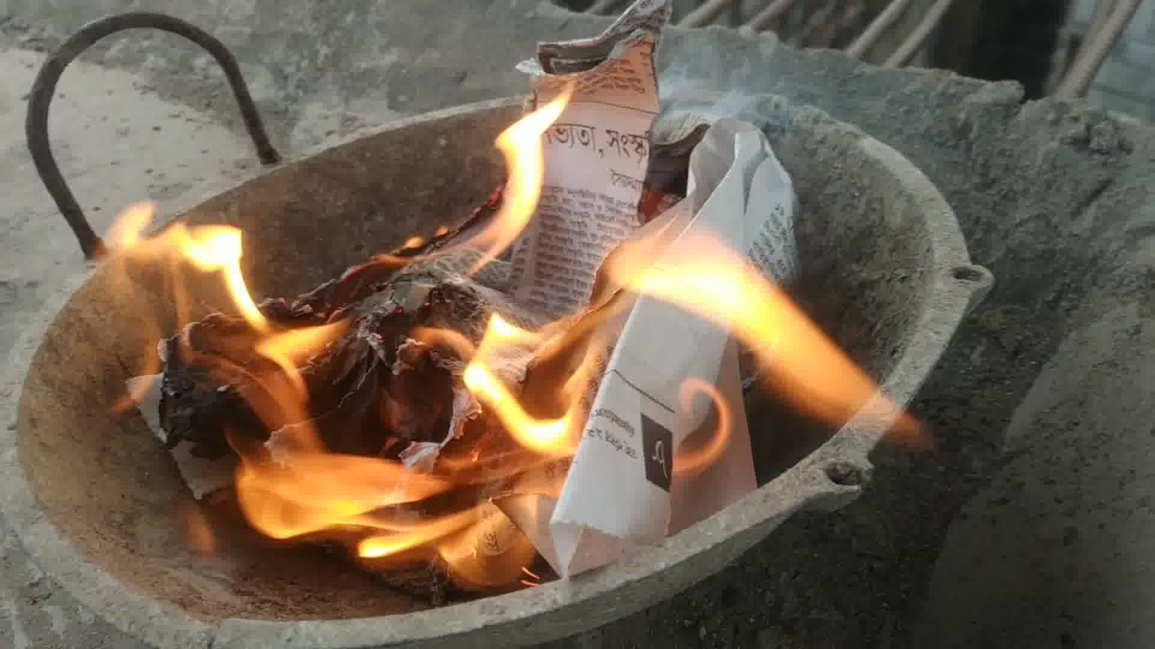

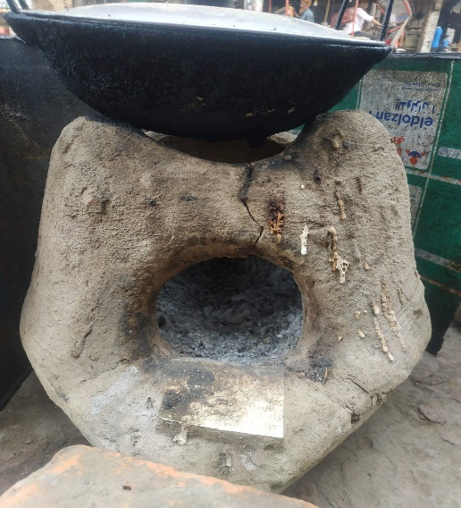
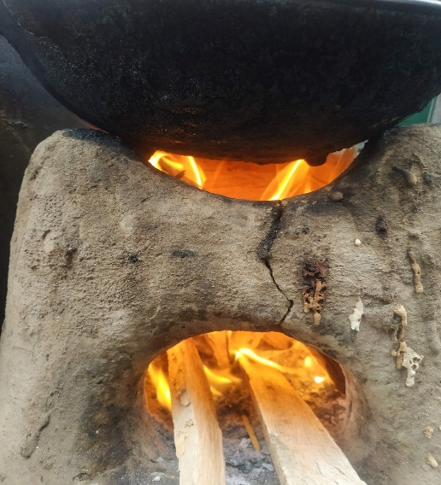
Dataset1
Opposite Image from Same environments Were Present
6

Slide 7
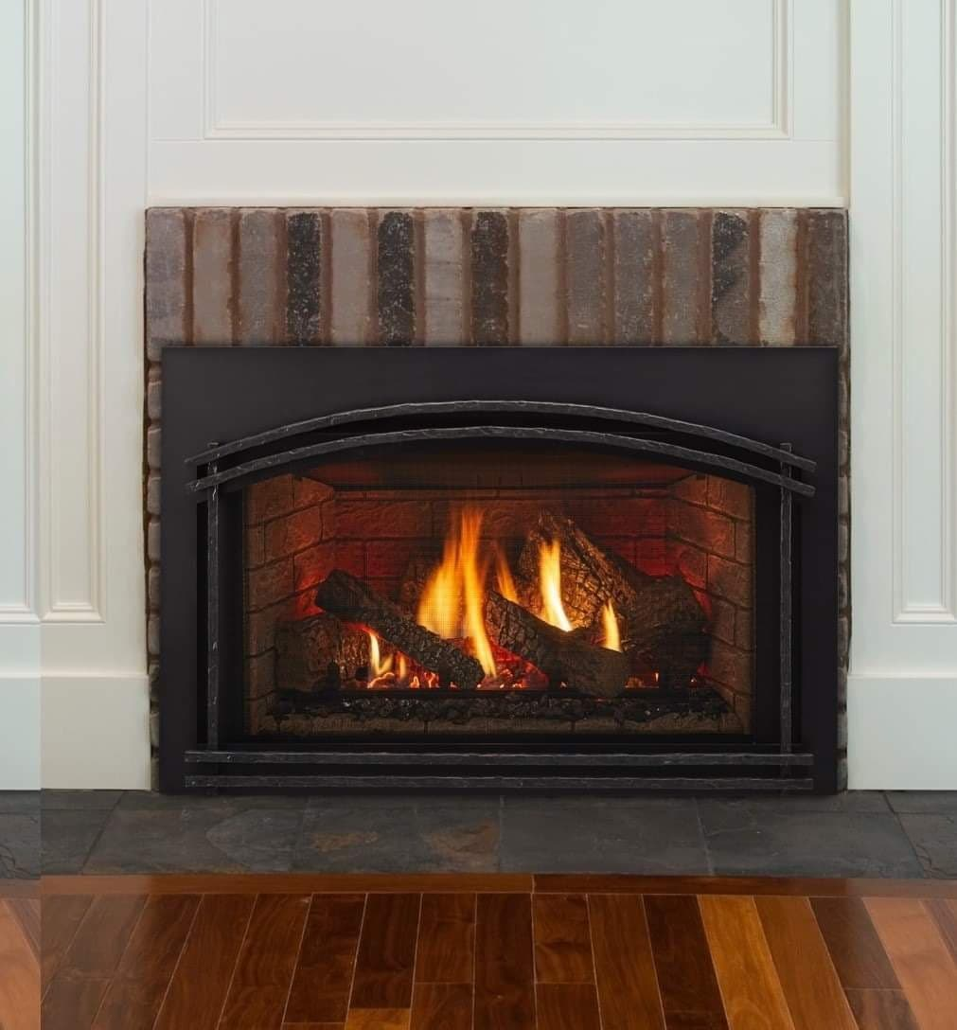
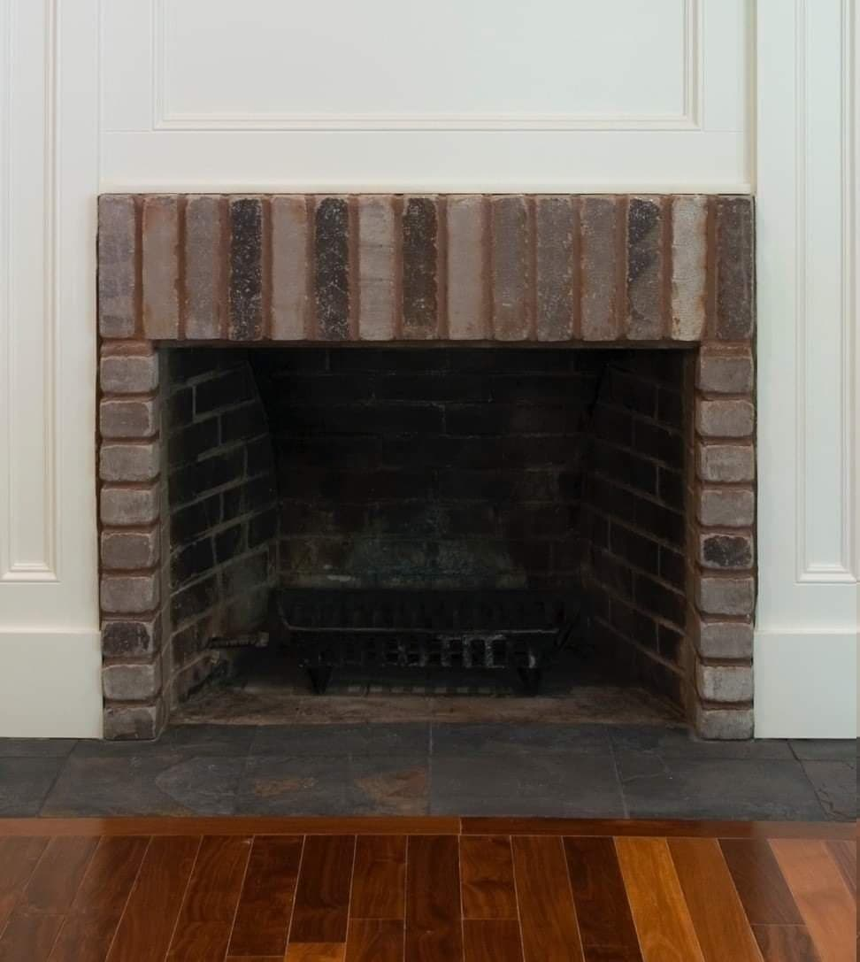
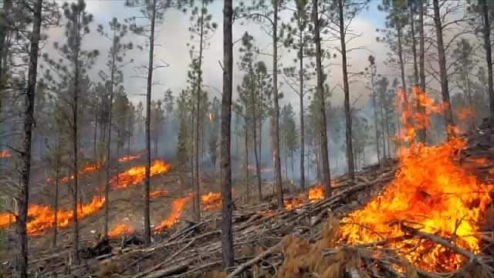
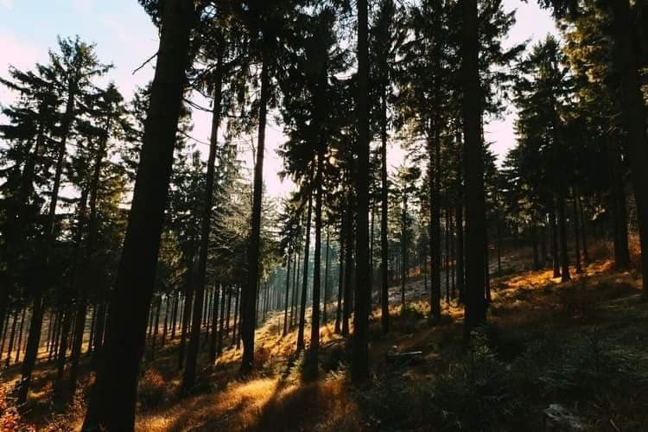
Dataset1
Emphasized on Background Similarity
7

Slide 8
Dataset2
Developed By Teachers and Students of Institute of Mathematics and Computer Science, University of Sao Paulo
Sao Carlos, Brazil
236 Images in Total
Contains Challenging Images
Presence of Fire Like Objects in Non-fire Section
8

Slide 9
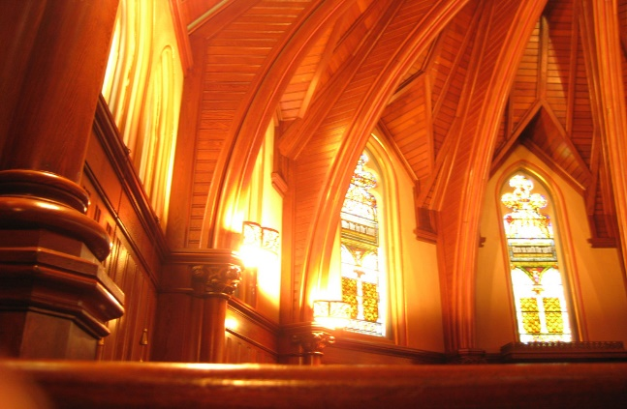
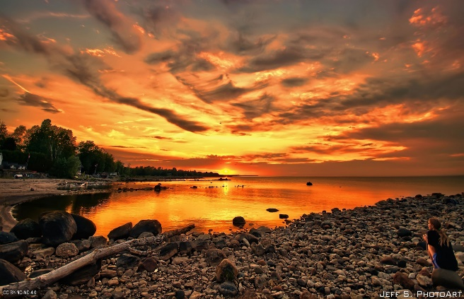
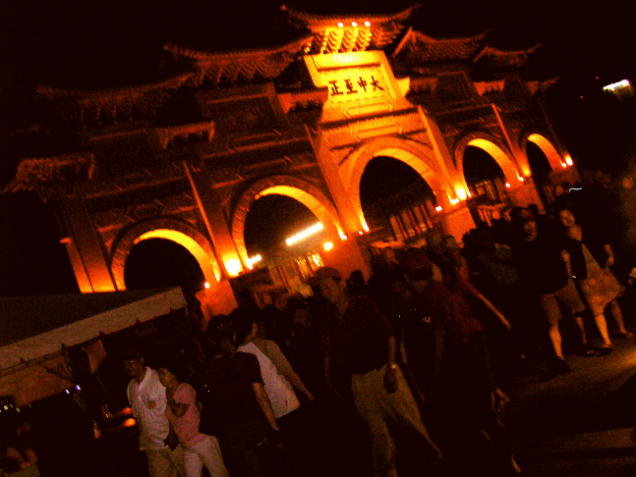

Dataset2
Presence of Fire Like Objects in Non-fire Section
9

Slide 10
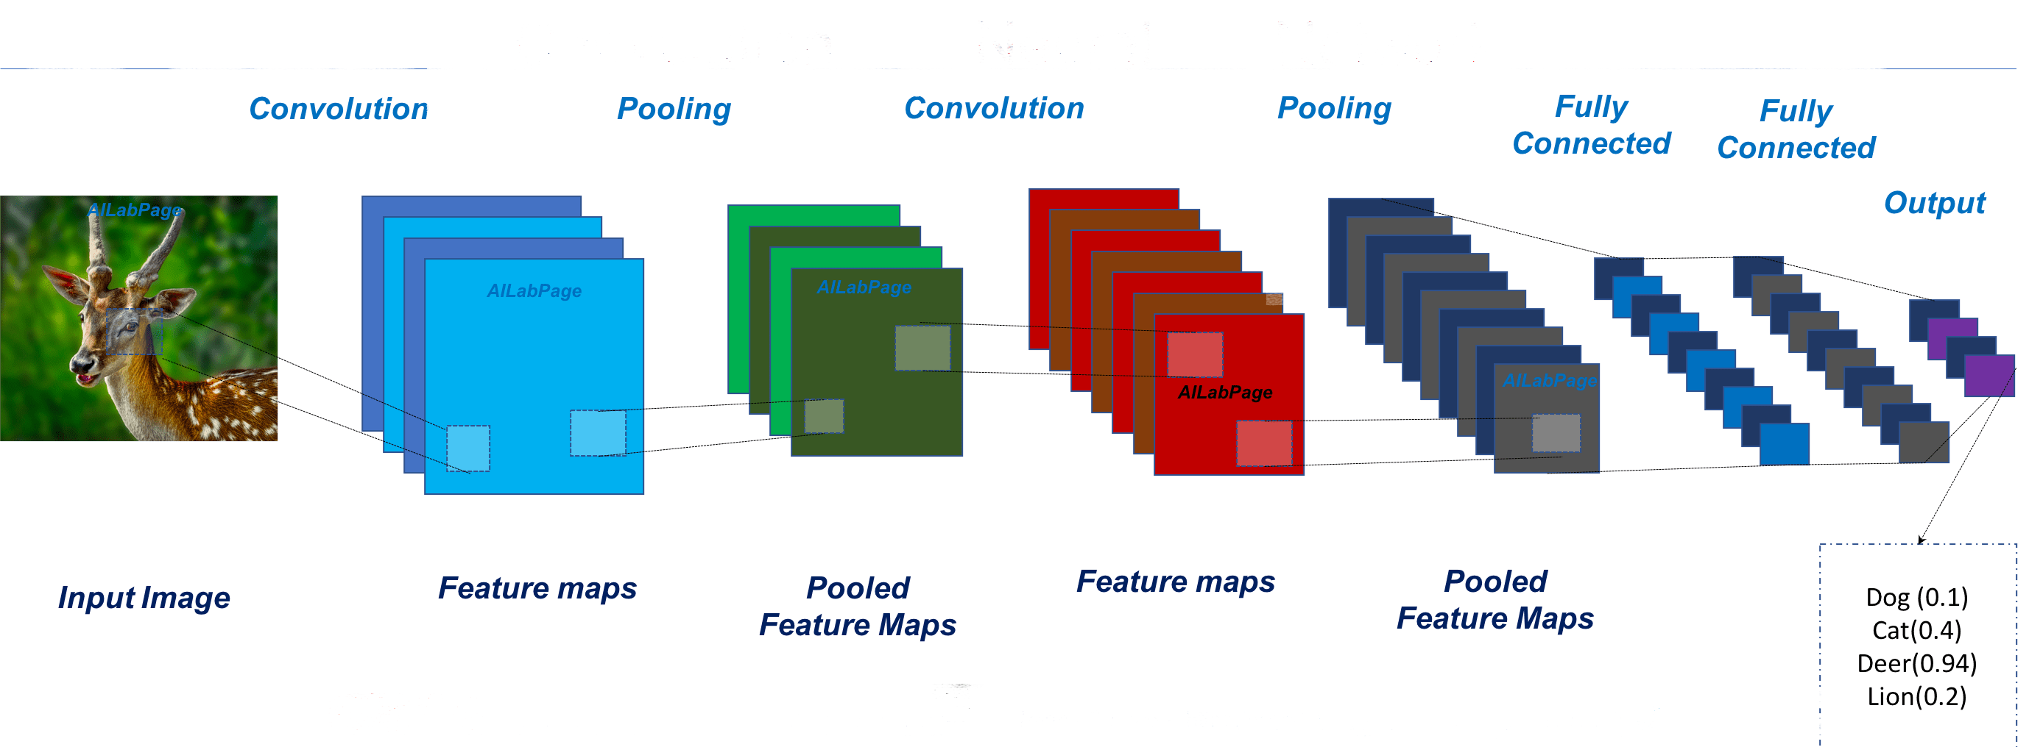
Convolutional Neural Network
10

Slide 11
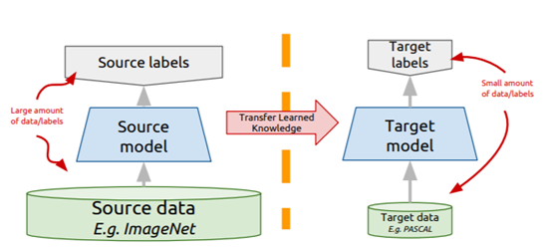
Transfer Learning
11

Slide 12
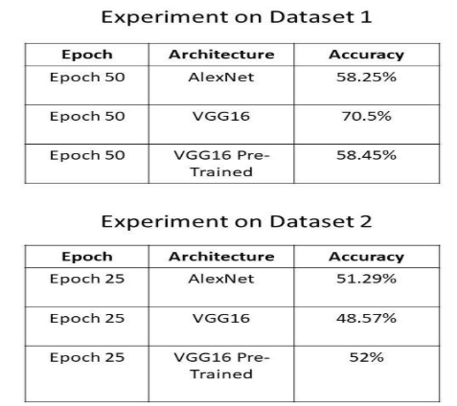
Previous Work
12

Slide 13
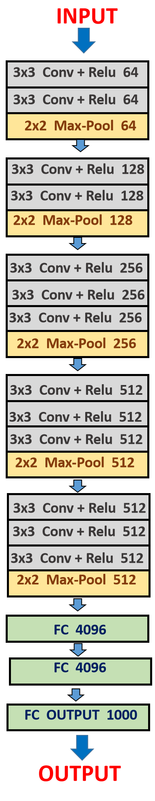
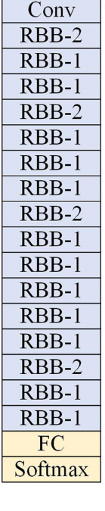
Pre trained Model of VGG16 & ResNet50
Freeze the layers as these are trained on ImageNet
For the image categories
13

Slide 14
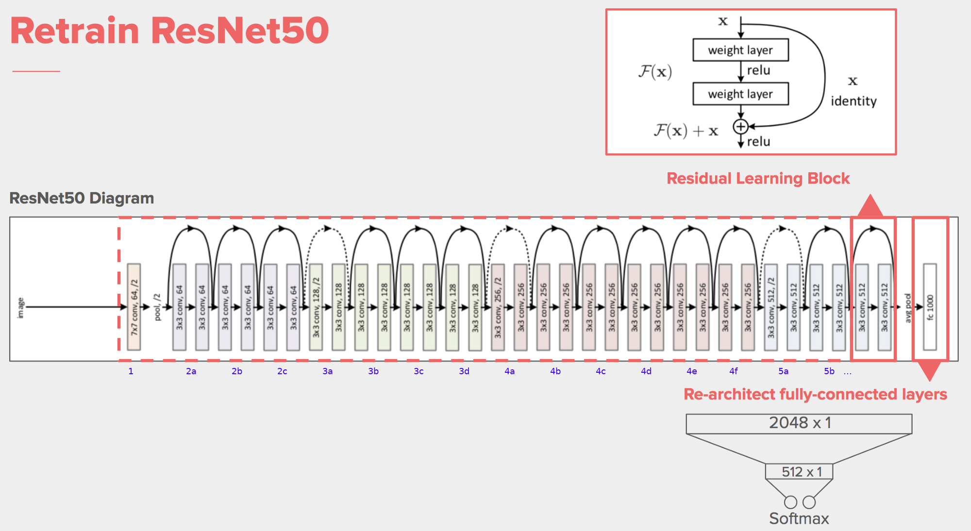
ResNet50 Architectural View
Residual neural networks do this by utilizing skip connections, or shortcuts to jump over some layers.
14

Slide 15
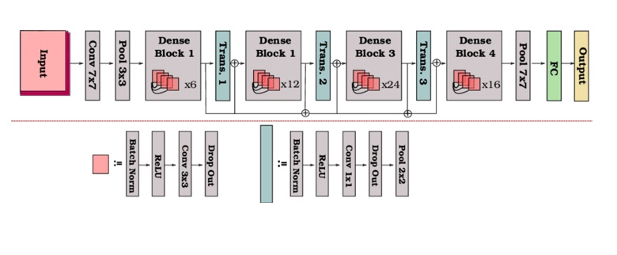
DenseNet121
DenseNets are divided into DenseBlocks, where the dimensions of the feature maps remains constant within a block, but the number of filters changes between them. These layers between them are called Transition Layers and take care of the downsampling applying a batch normalization, a 1x1 convolution and a 2x2 pooling layers.
15

Slide 16
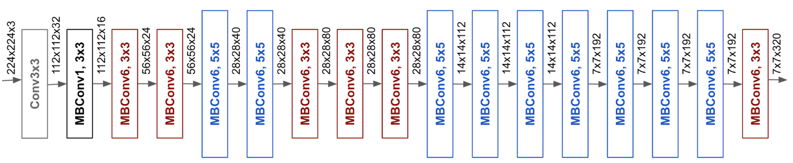
EfficientNet B0
The EfficientNet-B0 architecture wasn't developed by engineers but by the neural network itself
The base EfficientNet-B0 network is based on the inverted bottleneck residual blocks of MobileNetV2, in addition to squeeze-and-excitation blocks.
16

Slide 17
Individual model accuracy of this 4 architecture
CNN Architecture­­­­s | Training accuracy | Prediction accuracy
VGG16 | 95% | 84.64%
ResNet50 | 99% | 53.01%
Dense Net | 98% | 66.36%
Efficient Net | 97% | 60%
Dataset 1
Our formatted dataset
CNN Architecture­­­­s | Training accuracy | Prediction accuracy
VGG16 | 99% | 78.95%
ResNet50 | 100% | 52.63%
Dense Net | 100% | 76.32%
Efficient Net | 97% | 55%
Dataset 2
Collected dataset from base paper
17

Slide 18
Ensemble Method
Ensemble of Models use multiple learning algorithms to obtain better predictive performance
Is a solution to the high variance of neural networks is to train multiple models and combine their predictions.
reducing the variance & generalization error in the prediction, the ensemble can also result in better predictions than any single best model.
Data input
Model 1
Model 2
Ensemble
Prediction
Model 3
Dataset 1
Model 1
Dataset
Dataset 2
Model 2
Ensemble
Prediction
Dataset 3
Model 3
18

Slide 19
Ensemble Method
Average
Max Voting
Ensemble averaging creates a group of networks, each with low bias and high variance, then combines them to a new network with (hopefully) low bias and low variance
In max-voting, each base model makes a prediction and votes for each sample. Only the sample class with the highest votes is included in the final predictive class.
19

Slide 20
Accuracy Matrices
Precision - Precision is the ratio of correctly predicted positive observations to the total predicted positive observations.
Recall- Recall is the ratio of correctly predicted positive observations to the all observations in actual class – yes.
F1 Score- F1 Score is the weighted average of Precision and Recall.
20

Slide 21
Report Generated After Max Voting
1.DATASET 1(Our Dataset)
Class | Precision | Recall | F1-score | Max Voting
Fire | .84 | .89 | .87 | 85%
2.DATASET 2(Model Data)
Class | Precision | Recall | F1-score | Max Voting
Fire | .81 | .72 | .76 | 79%
21

Slide 22
Dataset 2
Comparison Result With Other Paper’s Models
Model Name | Precision | Recall | F1-score
Our Ensemble Model-using Max Voting | 0.81 | 0.72 | 0.76
Khan Muhammad et al | 0.86 | 0.97 | 0.91
Chino et al | 0.51 | 0.65 | 0.57
Rudz et al | 0.63 | 0.45 | 0.52
Rossi et al | 0.39 | 0.22 | 0.28
Celik et al | 0.55 | 0.54 | 0.54
Chen et al | 0.75 | 0.15 | 0.25
22

Slide 23
Object Detection with OpenCV
DATA
DETECTION
PRETRAINED MODEL ACCURACY
OPENCV FOR OBJECT DETECTION
TAKING PREVIOUS PRETRAINED MODEL ACCURACY
OPENCV FOR OBJECT DETECTION
TAKING PREVIOUS PRETRAINED MODEL ACCURACY
OPENCV FOR OBJECT DETECTION
IMAGE ACUISITION(WEBCAM)
DETECTION USING FIRE REGION DETECTION
FIRE
NO-FIRE
23

Slide 24
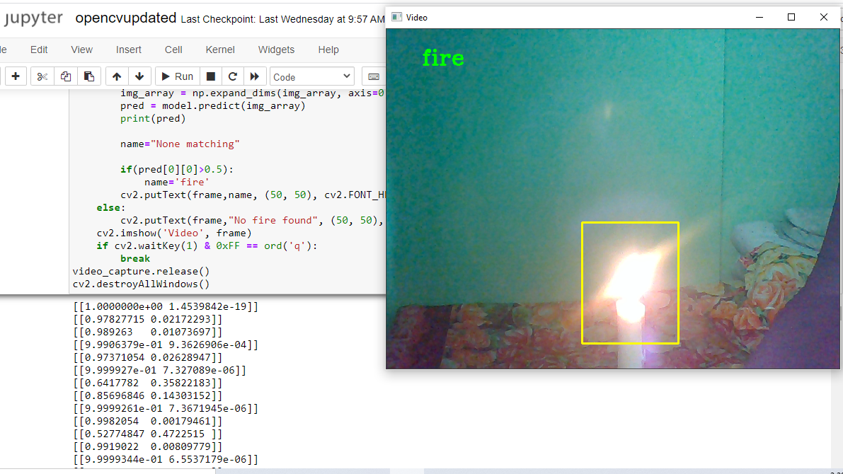
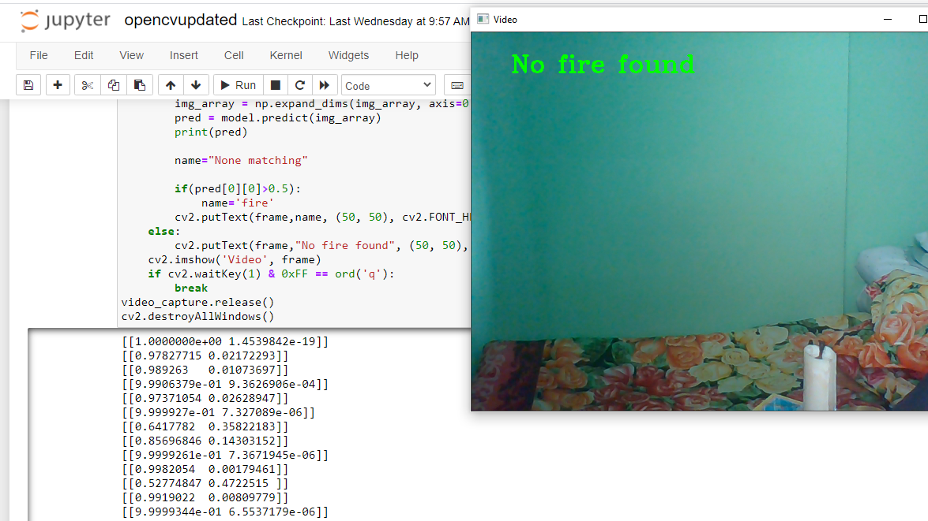
Detection Result
With fire | Without fire
24

Slide 25
m
LIMITATIONS
1.Applied some of the best architectures for image classification but there are still some other architectures to use
2.Only one ensemble method is used for image classification
3.Our object detection method works perfectly on static environment.
25

Slide 26


We worked on two datasets. One is our dataset and other is model dataset.
We use ensemble technique for better accuracy and got 85% accuracy.
Brief discussion
We use object detection and localization with basic OpenCV and VGG16 pretrained model
26

Slide 27


Future Work
Will work on increasing our dataset.
Will apply rest of the models which are best for image classification, such as Xception,InceptionV3 etc.
Will work on other advanced ensemble method for our image classification.
Will use ensemble method for object detection.
Will work on both static and motion for detection and apply advanced techniques like YOLOV3,RCNN.
Intellectual Property
&
Idea Protection
27

Slide 28
Thank You

Slide 29
Any Questions?

